Slide 1
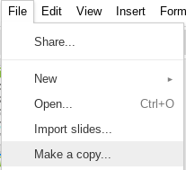
HOW TO EDIT:
If you would like to add a copy of this presentation to your own Google Drive, follow these steps:
Make sure you are signed into your Google Drive account
Click File
Click Make a Copy
Ta-dah! It's now in your Drive, so you can edit it for yourself, and add any other information you would like!

Slide 2
Name: _________________________________________________ Class: ________ Date:_______________
Snap
Story
Copyright © SrtaSpanish

Slide 3
Name: _________________________________________________ Class: ________ Date:_______________
Name: _________________________________________________ Class: ________ Date:_______________
Copyright © SrtaSpanish

Slide 4
Name: _________________________________________________ Class: ________ Date:_______________
3 things I learned..
2 interesting things
1 question I still have
Name: _________________________________________________ Class: ________ Date:_______________
3 things I learned..
2 interesting things
1 question I still have
Copyright © SrtaSpanish

Slide 5
Name: ________________
Name: ________________
Name: ___________
Name: ___________
Copyright © SrtaSpanish

Slide 6
Name: _________________________________________________ Class: ________ Date:_______________
Copyright © SrtaSpanish

