Slide 1
My friends are telling me that their is a new drug out there for HIV, but I am not sure if I believe them. Is there a new drug, and you you explain how it works?
@confusedteen
@_________________________________
How do I know when to go to the doctor? I mean some of my friends go once a week, and others only go once a year. #iamsoconfused
@confusedteen
_____________________________________________________________________________________________________________________________________________________________________________________#______________________
@confusedteen

Slide 2
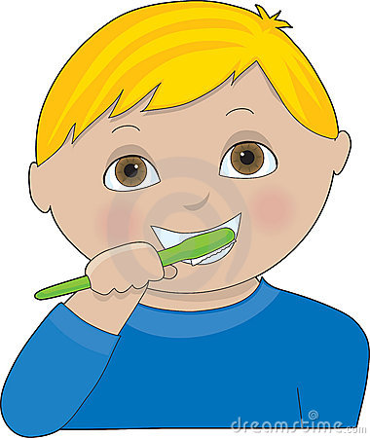
My biology teacher always tells me that my music is too loud, and that I am going to be hard of hearing when I am older. Will listening to my music loud on my airpods cause hearing damage? I mean, what does “loud” even mean? #ilovemymusic
@confusedteen
@________________________________
My partner and I are ready to become sexually active, but we want to get tested for Sexually Transmitted Infections first. Where can I go without my parents finding out? Does it cost money? #brokeconfusedteen #scaredteen
@confusedteen
_____________________________________________________________________________________________________________________________________________________________________________________#______________________
@________________________________

Slide 3
I LOVE the sun! I LOVE to be tan! I LOVE tanning beds. I just saw this video on YouTube, and now I am freaking out because I have this weird looking mole. What are signs of skin cancer, and where can I go to get checked? #freakedoutteen
@confusedteen
_____________________________________________________________________________________________________________________________________________________________________________________#______________________
@________________________________
_____________________________________________________________________________________________________________________________________________________________________________________#______________________
@________________________________
_____________________________________________________________________________________________________________________________________________________________________________________#______________________
@________________________________

