Slide 1
Components of Accelerated Learning
Lerin Parker, District-Based Instructional Specialist
Carrie Wade, School-Based Instructional Coach
August 9-10, 2023
Notes:
Share nonverbal signal for drawing participant’s attention.

Slide 2
The mission of Fayette County Public Schools is to create a collaborative community that ensures all students achieve at high levels and graduate prepared to excel in a global society.
Notes:
We are putting our mission into action today as we are learning as a collaborative community with the focus of ensuring that all students achieve at high levels.

Slide 3
Strategic Priorities
Notes:
The topic of Components of Acceleration aligns with our strategic priority of student achievement because acceleration is focused on rigorous instruction.

Slide 4
Alignment to Focus Area 3
Accelerated Learning: All schools will develop and implement standard-based instruction to accelerate learning.
Develop a common district learning platform that will be utilized by all staff that houses current curriculum frameworks, resources, and materials
Utilize district-developed frameworks and instructional design models to plan grade-appropriate and cognitively engaging instruction
Utilize identified gap data and aligned curriculum to differentiate supports to improve outcomes for all students
Monitor and report classroom and individual student progress
Understand how to implement the initial components of a systems approach to continuous improvement.
Notes:
FCPS has developed an Acceleration Model of best practices to ensure all students have access to quality tier 1 instruction.
Goals of the FCPS Acceleration Model:
1. All students have access to grade-appropriate assignments focused on essential standards.
2. All students have access to high-quality instruction that addresses gaps identified through pre-assessment within the context of grade-appropriate assignments focused on essential standards.
3. All students are demonstrating mastery of grade-level standards.

Slide 5
Professional Learning Norms
Establish a safe environment where every person and their ideas are respected.
Creating a space where individuals feel comfortable expressing their thoughts and opinions without fear of judgment or ridicule promotes a culture of inclusivity, open-mindedness, and mutual respect, fostering collaborative discussions and encouraging diverse perspectives to be heard and valued.
Be present and engaged.
Be present and engaged by being mentally and physically attentive, avoiding distractions, and actively participating in discussions.
Put Ideas on the Table
Ideas are the heart of a meaningful dialogue. Label the intention of your comments. For example, you
might say, “Here is one idea . . . ” or “One thought I have is . . . ” or “Here is a possible approach . . . ”
Presume positive intentions
Assuming that others’ intentions are positive promotes and facilitates meaningful dialogue and eliminates
unintentional putdowns. Using positive intentions in your speech is one manifestation of this norm.

Slide 6
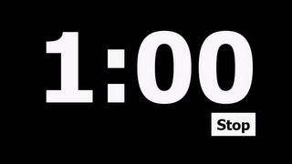
Which One Doesn’t Belong?
scaffolded | prerequisite
essential | reteach
pre-assessment | vocabulary
formal formative | informal formative
misconceptions | preview
Think time for 30 seconds.
At 30 seconds, talk with a table partner
about your choice and explain why.
Notes:
What? An instructional strategy where all students have an entry point because there is no right or wrong answer. Why? The purpose is to get students engaged with the content. How?
When the timer starts, read through the list of words.
Choose the word you feel does not belong with the others.
When the timer is at 30 seconds, share your word and reasoning with a table partner.
What clarifications might you need before I start the timer?

Slide 7
Visible Learning
Learning Intention
Success Criteria
I am learning to provide “just-in-time” support on grade level standards to accelerate learning for all students grades K-12.
I can identify components of accelerated learning.
I can explain how the components are incorporated into the FCPS Acceleration Model.
I can plan next steps to enhance my instructional practices.
Notes:
Read aloud LI and SC

Slide 8
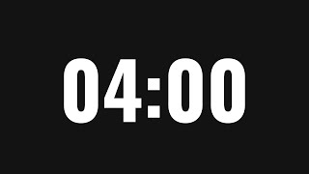
The Acceleration Framework
Grab an article from the middle of the table.
Find the step that coordinates with the number at the top of the article.
Independently read your assigned section and jot any important information on a post-it note.
Notes:
Purpose: Read the research that helped develop components of the FCPS Acceleration Model.
An important point to emphasize is that the author often mentions an acceleration class but that the same teacher may serve both roles. The approach to our district model is that acceleration is a part of tier 1 instruction. Also notice that Step 2 uses the verbiage of Learning Goal and Expectations which is Teacher Clarity and aligns with our verbiage of Learning Intentions and Success Criteria.
Go through Jigsaw directions and set timer.
SET UP: To save time, each table should have articles labeled 1-6. The number indicates the step the participant will read as well as their expert group table.

Slide 9
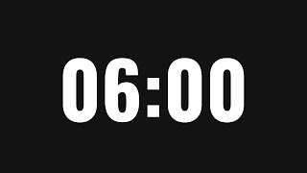
The Acceleration Framework
Share what you’ve learned.
Person 6 is the timekeeper.
Each person has 1 minute to share their expertise with the group.
Person 1 starts the conversation.
Every component should be discussed.
Notes:
Participants share their learning with the rest of their table mates.

Slide 10
Components of Acceleration
Generate Thinking, Purpose, Relevance, and Curiosity
Increases student motivation
Creates value, relevance, and interest
Fosters both motivation and long-term retention of content
Clearly Articulate the Learning Goal and Expectations
Promotes visible learning by having explicitly stated, student friendly learning intentions
Builds connections to prior learning which leads to improved long term memory and retrieval
Scaffold and Practice Essential Prerequisite Skills
Asks what students need “just in time” to be successful with current standard
Addresses high-priority gaps prior to tier 1 instruction

Slide 11
Components of Acceleration
Introduce New Vocabulary and Review Prior Vocabulary
Promotes early-on success and confidence with the content
Builds students’ deep, sustained knowledge of vocabulary
Dip Into the New Concept
Encourages students’ self-efficacy and enthusiasm
Develops background knowledge of grade-level content
Conduct Formative Assessment Frequently
Utilizes data for immediate adjustment of instruction
Gives timely and detailed feedback from teachers and peers

Slide 12
FCPS Acceleration Model
Preview Upcoming Essential Standard(s)
Responsive Tier 1 Instruction
Reteach/Enrich After Common Assessment
Notes:
Most of the research material you read today, suggests that acceleration is previewing content for identified students. While the development team supports the strategies presented in Learning in the Fast Lane, the team agreed that the acceleration model should be more comprehensive.
There are three sections of the model (click to display each section)
As we read the district model, we are actually going to read them out of order because you are familiar with the majority of the information and may already be implementing some acceleration strategies in your schools. This Acceleration Model is reorganizing best practices you already know in a new, intentional way.

Slide 13
Say Something
Partners independently read the assigned section.
When both partners are done reading, turn and “Say Something.” It could be a:
question
brief summary
interesting point
personal connection
Reteaching After Common Assessment pg. 3
Notes:
What: Say Something is a strategy to process text and information.
Why: The purpose of the strategy is to interpret information and relate it to your own experience.
Here is how it works:
Read through the strategy description. Reminder, you are actually going to read the document backwards starting with the reteach section on page 3.
What clarification might you need before you start?
Click for each section and corresponding timer.

Slide 14
Connection to FCPS Acceleration Model
Generate Thinking, Purpose, Relevance and Curiosity
Clearly Articulate Learning Goals and Expectations
Conduct Formative Assessment Frequently
Reteaching After Common Assessment
Tight | Loose
Plan instructional response to remediate, reteach, and enrich acquisition of the standard Implement varied instructional approaches Reassess after reteach | Whole group vs small group Pile, Stack, Plan protocol (will be linked) Method of reassessment after reteach Varied formal formative assessments Varied informal formative assessments
Notes:
When you’re thinking about the reteach portion, did anything stand out to you regarding these components?
Two Participants share a “Say Something” comment about the connection between the FCPS Model and the Acceleration Framework components identified on this slide.
Presenter highlight: Notice in the “Tight” it mentions reassessing after reteach. Timing of this may vary depending on the recurrence of the standard. For example, reading is cyclical so standards may be revisited in other units. Teachers may choose to only assess one or two of the success criteria and then add others when the standard is repeated in a future unit. This will require teachers to look ahead on the pacing guides to plan accordingly.

Slide 15
Say Something
Partners independently read the assigned section.
When both partners are done reading, turn and “Say Something.” It could be a:
question
brief summary
interesting point
personal connection
Reteaching After Common Assessment pg. 3
Responsive Tier 1 Instruction pg. 2
Notes:
Explain we are going to use the same structure to read the next section.
Click for each section and corresponding timer.

Slide 16
Connection to FCPS Acceleration Model
Responsive Tier 1 Instruction
Generate Thinking, Purpose, Relevance and Curiosity
Clearly Articulate Learning Goals and Expectations
Conduct Formative Assessment Frequently
Tight | Loose
Choose vocabulary based on the language of the current standard(s) Deliver explicit vocabulary instruction Utilize essential standards identified within the Unit Frameworks Monitor instruction through the use of formative assessments Track student progress using formative assessment data Link standard from whole group when utilizing small group instruction | Whole group vs small group Type of formative assessments Monitoring plan for formative assessment data
Notes:
When you’re thinking about the responsive tier 1 instruction, did anything stand out to you regarding these components?
Two Participants share a “Say Something” comment about the connection between the FCPS Model and the Acceleration Framework components identified on this slide.

Slide 17
Say Something
Partners independently read the assigned section.
When both partners are done reading, turn and “Say Something.” It could be a:
question
brief summary
interesting point
personal connection
Reteaching After Common Assessment pg. 3
Responsive Tier 1 Instruction pg. 2
Previewing Upcoming Essential Standards pg. 1
Notes:
The final section of the acceleration model is previewing upcoming essential standards. We feel this section may be new information for some schools or a strategy that may need to be modified for effectiveness.
As you read this section, you are going to continue using the Say Something strategy.
What clarification might you need before I start the timer?
Click for each section and corresponding timer.

Slide 18
Connection to FCPS Acceleration Model
Preview Upcoming Essential Standards
Scaffold and Practice Essential Prerequisite Skills
Introduce New Vocabulary and Review Prior Vocabulary
Dip into the New Concept
Tight | Loose
Administer pre-assessment 1-2 weeks before the unit Choose vocabulary based on the language of the upcoming standard(s) Deliver explicit vocabulary instruction Utilize prerequisite skills and standards progression identified within the Unit Frameworks Utilize prerequisite skills within one grade-level of current standard Introduce content with authentic/real-world tasks Preview 1 to 3 days prior to new standard | Whole group vs small group Authentic/real world task bank Based on pre-assessment, decide preview intensity 1-3 days of previewing Components of preview lessons Example: Day 1- Authentic Task/Vocabulary Day 2- Prerequisite skill Day 3- Least complex grade-level success criteria
Notes:
Participants share a “Say Something” comment about the connection between the FCPS Model and the Acceleration Framework components identified on this slide.
Presenter highlight: In this section of the model, it states to Identify targeted students based on pre-assessment data and possible subgroups specified in school’s CSIP goals. This is specific to your school and could include such subgroups as economically disadvantaged students or EL students to name a few.

Slide 19
Parking Lot
https://bit.ly/FCPSAPL
Notes:
One question we anticipate you having is, how do we make this all happen?
As a resource, we have developed a SAMPLE schedule that can help you process implementing the Acceleration Model.
We realize that you might have questions about the schedule; therefore, we’ve created a parking lot where you can ask your questions and we will respond as you work today.

Slide 20
Model Overview Schedule
Aug. 21 | Aug. 22 | Aug. 23 | Aug. 24 | Aug. 25
Preview Upcoming Standard(s)
Current Standard(s) |  | Formal Formative | Current Standard(s)
 | Pre-assessment |  | Reteach/Enrich | Reteach/Enrich
What do you notice or wonder?
Think time for one minute.
At 1:00, talk with a table partner
about your notice or wonder.
Aug. 28 | Aug. 29 | Aug. 30 | Aug. 31 | Sept. 1
 | Preview Upcoming Standard(s)
Current Standard(s) |  |  | Formal Formative | Current Standard(s)
Reteach/Enrich/ Formative Reassessment |  |  |  | Reteach/Enrich
Sept. 4 | Sept. 5 | Sept. 6 | Sept. 7 | Sept. 8
 |  | Preview Upcoming Standard(s)
Current Standard(s) |  |  |  | Formal Formative
Reteach/Enrich | Reteach/Enrich/ Formative Reassessment |  | Pre-assessment
Notes:
Introduce notice and wonder strategy.
What: A strategy that promotes observation skills and generating ideas.
Why: Supports classroom community and confidence in abilities by giving all students access to the task.
Here is how the strategy works: (go through directions on slide)
What clarification might you need before I start the timer?

Slide 21
Plan Into Practice
https://bit.ly/FCPSNAV
Visit Navigator and find the pacing
guide for your grade level and content area.
Complete essential standards, supporting standards, approximate days of instruction, and the common assessment window on the Acceleration Planning Schedule.
Notes:
We want to emphasize this is a sample schedule and not a mandate; however, we thought it would be helpful to model the process for acceleration that we discussed today. We realize the big question may be, “How do we make this all happen?”
One thing to consider when making a plan is some standards will be visited in a subsequent unit; therefore, that may influence how in depth you teach the standard.
Go through the process on the slide.

Slide 22
Plan Into Practice
3. Decide pacing of each standard. How many days or
weeks per standard or cluster of standards? Draw
lines to indicate when each standard will be covered.
4. List each standard in the section it will be taught.
Notes:
The next part of the planning process is focusing on how to take the entire unit and break it up into smaller chunks. Note on some of the frameworks such as grades 3-5 mathematics frameworks, suggested time frames for individual or clusters of standards have been suggested. While your pacing will depend on the needs of your students and the results of formative data, you can make a plan and adjust accordingly.
Go over directions for this portion of the planning process.

Slide 23
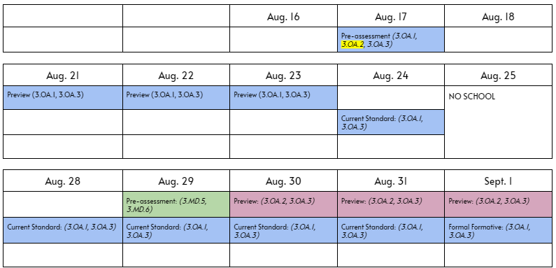
Plan Into Practice
5. Based on the pacing for each standard, decide when to complete the following:
Pre-assessment
Preview
Teach current standard
Conduct formal formative
Reteach/Enrich
Notes:
Go over directions for last step of planning process. During work time, presenters can respond to parking lot questions.

Slide 24
Plan Into Practice
https://bit.ly/FCPSNAV
Visit Navigator and find the third grade pacing
guide for ELA.
Complete essential standards, supporting standards, approximate days of instruction, and the common assessment window on the Acceleration Planning Schedule.
Notes:
We want to emphasize this is a sample schedule and not a mandate; however, we thought it would be helpful to model the process for acceleration that we discussed today. We realize the big question may be, “How do we make this all happen?”
One thing to consider when making a plan is some standards will be visited in a subsequent unit; therefore, that may influence how in depth you teach the standard.
Go through the process on the slide.

Slide 25
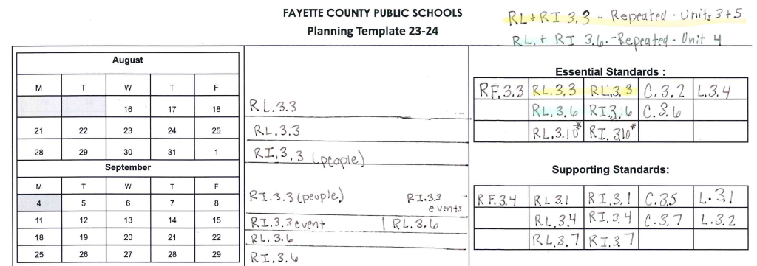
Plan Into Practice
3. Decide pacing of each standard. How many days or
weeks per standard or cluster of standards? Draw
lines to indicate when each standard will be covered.
4. List each standard in the section it will be taught.
Notes:
The next part of the planning process is focusing on how to take the entire unit and break it up into smaller chunks. It’s important to note that standards RL.10 and RI.10 contain the wording “By the end of the year” so students learn strategies for that standard through teaching of other comprehension standards so it is listed, but we will not teach that standard in isolation.
Also, notice that there is a note about standards 3.3 and 3.6 because they will be repeated in subsequent units. You’ll see that standard RI.3.3 is about relationships between individuals, historical events, and scientific ideas or concepts in technical procedures over the course of a text. Since I know this well be repeated, I am only choosing to focus on the relationships between people and relationships between events during this unit. The next time we visit this standard we will focus on relationships in scientific ideas or concepts and steps in a technical procedure.
While your pacing will depend on the needs of your students and the results of formative data, you can make a plan and adjust accordingly.
Go over directions for this portion of the planning process.

Slide 26
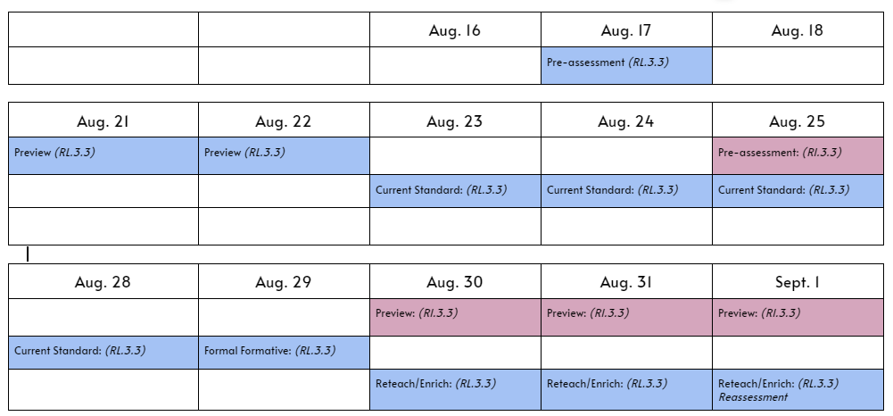
Plan Into Practice
5. Based on the pacing for each standard, decide when to complete the following:
Pre-assessment
Preview
Teach current standard
Conduct formal formative
Reteach/Enrich
Notes:
Go over directions for last step of planning process. During work time, presenters can respond to parking lot questions.

Slide 27
Scrambled Sentences
Each person at the table needs one post-it note.
On the post-it note, write one word that describes your learning about the last three slides over scheduling.
Share your word with the group.
The group constructs a sentence that uses all the words, while adding as few words as possible.
Choose a spokesperson to share out with the room.
Notes:
Why: The purpose of the strategy is to review information you have learned.
Here is how it works: Go through the process on the slide.
What clarification might you need before I start the timer?

Slide 28
Which One Doesn’t Belong?
scaffolded | prerequisite
essential | reteach
pre-assessment | vocabulary
formal formative | informal formative
misconceptions | preview
Think time for 30 seconds.
At 30 seconds, talk with a table partner
about your choice and explain why.
Notes:
When the timer starts, think about the context of the words in relation to the FCPS Acceleration Model. What word would you choose now?
At 30 seconds, share your thoughts with your table partner.
What clarification might you need before I start the timer?

Slide 29
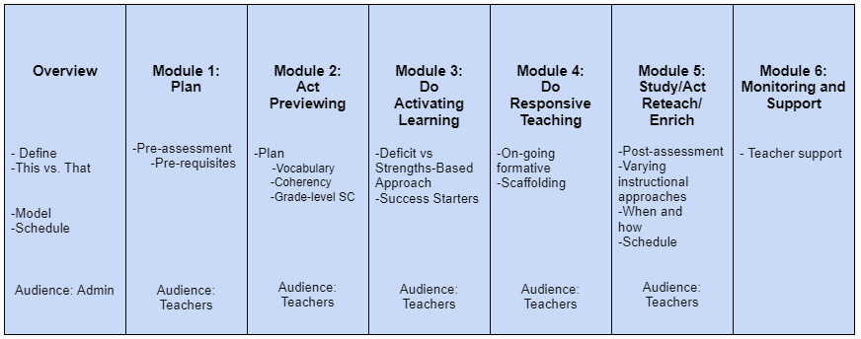
Acceleration Continuum
http://bit.ly/3DuBaBD

Slide 30
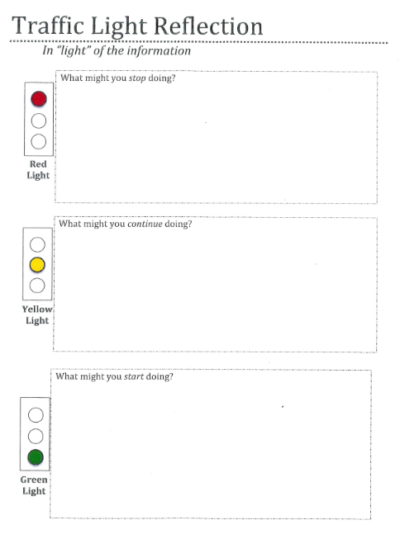
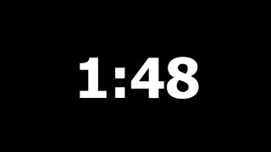
Current Reality and Next Steps
Use this time to reflect on content and connect the information to your own work using the Stoplight Strategy.
http://bit.ly/3OxlzHy
Notes:
As we close, we want to be sure to give you time to process the information you learned today and think about next steps. To do that, we are going to use the Stoplight Strategy.
Why? This strategy promotes reflection of the content and connection to your own work. Here is how the Stoplight Strategy works.
What clarification might you need before I start the timer?
The Bitly is a 3 then the letter O, not a zero

Slide 31
Visible Learning
Learning Intention
Success Criteria
I am learning to provide “just-in-time” support on grade level standards to accelerate learning for all students.
I can identify components of accelerated learning.
I can explain how the components are incorporated into the FCPS Acceleration Model.
I can plan next steps to enhance my instructional practices.
Notes:
Conduct fist to 5 of each success criteria.

Slide 32
Further Support
If you need any support, please contact us:
Jill Ingram - District-Based Instructional Specialist
jill.ingram@fayette.kyschools.us
Lerin Parker - District-Based Instructional Specialist
lerin.parker@fayette.kyschools.us
Aaron Davis - District-Based Instructional Specialist
aaron.davis@fayette.kyschools.us

