Slide 1
Math Instructional Design Models
for Teachers
August 2023
Presenters:
Shelley Dickson, District Math Specialist
Leslie Hammer, School Based Instructional Coach
Notes:
Welcome participants.
Share name of presenters.

Slide 2
The mission of Fayette County Public Schools is to create a collaborative community that ensures all students achieve at high levels and graduate prepared to excel in a global society.
Notes:
Read mission

Slide 3
Strategic Priorities
Notes:
Share where IDMs fall in the strategic priorities. (student achievement) “These are our Strategic Priorities for the year. Math Instructional Design Models fall under the strategic priority of Student Achievement. “

Slide 4
Alignment to Focus Area 3
Accelerated Learning: All schools will develop and implement standards-based instruction to accelerate learning.
Understand the district-developed frameworks and instructional design models.
Leverage the PLC process to plan grade appropriate and cognitively engaging instruction.
Learn strategies for differentiation.
Develop an understanding of culturally responsive teaching.
Understand how to implement the initial components of a systems approach to continuous improvement.
Notes:
The FCPS Professional Learning plan - focus area 3: accelerated learning.
Read the part in green.
The bolded piece is the part we are focusing on today.

Slide 5
Professional Learning Norms
Establish a safe environment where every person and their ideas are respected.
Creating a space where individuals feel comfortable expressing their thoughts and opinions without fear of judgment or ridicule promotes a culture of inclusivity, open-mindedness, and mutual respect, fostering collaborative discussions and encouraging diverse perspectives to be heard and valued.
Be present and engaged.
Be present and engaged by being mentally and physically attentive, avoiding distractions, and actively participating in discussions.
Put Ideas on the Table
Ideas are the heart of a meaningful dialogue. Label the intention of your comments. For example, you
might say, “Here is one idea . . . ” or “One thought I have is . . . ” or “Here is a possible approach . . . ”
Presume positive intentions
Assuming that others’ intentions are positive promotes and facilitates meaningful dialogue and eliminates
unintentional putdowns. Using positive intentions in your speech is one manifestation of this norm.
Notes:
Share norms for session today.

Slide 6
Solve this problem… you may work with a partner.
3 eighths of x is 27.
What is: x + 3 x ?
8
How did you solve? Share your strategy at your table.
What could make it easier?
How do you feel?
Notes:
Have a few people share out with the whole room.
Then proceed to the next slide.

Slide 7
Now try this problem…
again, you may work with a partner.
Han Solo checked his laser gun. Only three eighths of the energy pack was left. That is enough for 27 shots. Luke Skywalker threw him another fully charged pack. How many shots did Han have left then?
How did you solve this time?
Share your strategy at your table.
What did you notice?
What do you wonder?
Notes:
Show video clip for fun!
Have teachers solve and then have a few people share notices and wonderings with the whole room.
What is feedback about story problem?
Then proceed to the next slide.

Slide 8
Did you solve it like this?
What strategies did this student use?
Did it make sense to you?
What else did you notice?
Notes:
Watch student solve in video. Discuss strategy with partner.
Final comments.
Purpose to bring to light - We need to be intentional when we are planning on how we can support students. When you first saw the fraction and multiplication, you might have felt like you didn’t know how to attack the problem. But by giving you context, it was easier. In this session, we are going to talk about Instructional Design models for math that can help us rethink how we might structure our math block in different ways to meet the needs of our students and still hit the rigor of the standard.

Slide 9
Visible Learning
Learning Intention:
We are learning about the purpose of Instructional Design Models (IDM) for math.
Success Criteria:
I can explain the purpose of Instructional Design Models for math.
I can describe how I could effectively implement an IDM into my math instruction.
Notes:
As we move forward today, think about the problems you solved, how it made you feel, and how it connects to today’s learning. Review Learning Intention and Success Criteria.

Slide 10
What is an FCPS Instructional Design Model (IDM)?
IDMs are structures that…
Support the acquisition and application of knowledge and skills
Consider how students learn
Outline effective ways in which educators deliver information to students
Provide time allocation options for each content area
Help teachers in reaching the rigor of the standard and the needs of students
Ensures students are exposed to standards in several ways
Explicit Tier I instruction
Intentional, independent practice
Collaboration and other 21st century skills
Whole group
Small group
Notes:
Say first: Some of you may be wondering…what is an Instructional Design Model, or IDM for short. In a nutshell, IDMs…(read the first three bullets).
After the third bullet: The OAS team used a variety of research-based resources to develop the models.
After the fourth bullet: Emphasize these are not mandatory, but suggestions. The time allocations you will see embedded in the IDMs can be adapted to meet the particular needs of your school.
After the last bullet: The IDMs are resources to support schools in incorporating best practices in instruction across all content areas and good teaching strategies.

Slide 11
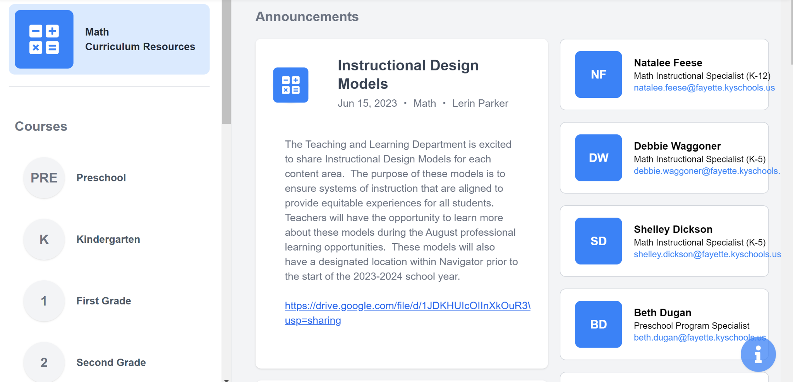
Where can I find the Instructional Design Models?
Notes:
Once you login into navigator, click on “math” on the left side and an announcement is posted at the top of the math page.

Slide 12
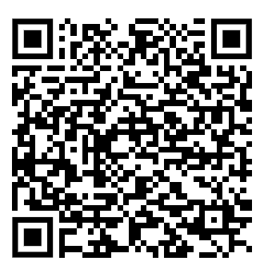
My current state…
Topic: Instructional Design Models
What does instruction look like in your school in mathematics?
Think about your master schedule. How much time do you have dedicated to your math block?
Record your thinking on the top half of the Reflection Handout.
Notes:
To get us started, let’s reflect on what you currently have in place at your school for your instructional areas of math. Think about your school’s master schedule. What is the structure of your math block and how much time do you spend on each part? Record your thinking on the top half of the reflection handout (allow time for completion.)
After teacher reflection, share out. Acknowledge positive things happening in classroom. “We are taking all of these ideas and putting them into a package.
(Teachers will complete a document with a series of questions which will require them to reflect on their current systems/practices they have in place for math addressed through the IDMs)

Slide 13
Instructional Design Models
Each member selects a different IDM.
Then…
read the corresponding IDM handout.
use the Knew, New, Q reading strategy and a pencil or highlighter to code the text.
Feel free to explore more than one IDM if time allows.
Notes:
Using what you know about your classroom, select a math IDM you would like to explore on a deeper level (allow time for decision making)
At your table there are copies of the IDMs’ There are four IDMs- two for whole group and two for small groups. Choose one of the the IDMs to read. To help you in the analysis of the IDM, you are going to use a text coding strategy.
The text coding strategy you are going to use is called KNEW, NEW, Q. Use this strategy to identify items that you KNEW or are already implementing or items that are NEW or that you hadn’t considered before or would like to implement, or Q questions that you are wondering about and would like to know more.
Go over the codes. If you have enough time you may read through more than one IDM
Questions?
Allow participants time to read the IDM and use the coding strategy.
After the participants have completed the reading (about 5-10 minutes) get their attention.
Teachers will then share with their group. As each team member shares, capture notes on your reflection sheet about each IDM.

Slide 14
Collaborative Discussion and Planning
With your group, discuss…
Compare your current mathematics instruction to each of the IDMs.
How are they alike and different?
Which one would be most effective for you to implement into your current math practices?
Notes:
Share out with whole group. (3-5 minutes)
Now that you’ve had time to review your IDM, engage in a collaborative discussion with your colleagues about what you’ve read. Discuss your codes and share possible ideas for new school year..

Slide 15
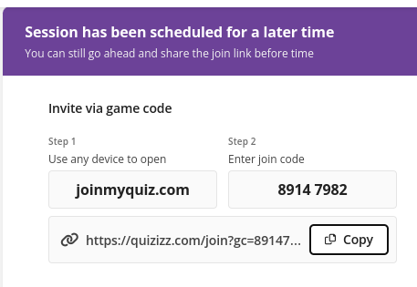
IDM Math Poll - Quizziz
Notes:
Before leaving today, let us know which IDM would you most likely consider implementing into your current math practices for whole group.

Slide 16
Visible Learning
Learning Intention:
We are learning about the purpose of Instructional Design Models (IDM) for math.
Success Criteria:
I can explain the purpose of Instructional Design Models for math.
I can describe how I could effectively implement an IDM into my math instruction.
Notes:
Review learning intention and success criteria.
Stand up if you can explain the purpose….
Stand up if you can describe how you might effectively implement….
Turn and talk to a neighbor about one thing you learned or would like to try.

Slide 17
shelley.dickson@fayette.kyschools.us
leslie.hammer@fayette.kyschools.us

